Slide 1

Is it Worth it? Returns to Investments
in Tertiary Education
Harry Anthony Patrinos
February 25, 2020
@hpatrinos

Slide 2

Introduction
Since 1980s private returns to schooling increased
Private returns to education were highest for primary
Recent evidence suggests pattern changed
Private returns to tertiary education increased most

Slide 3
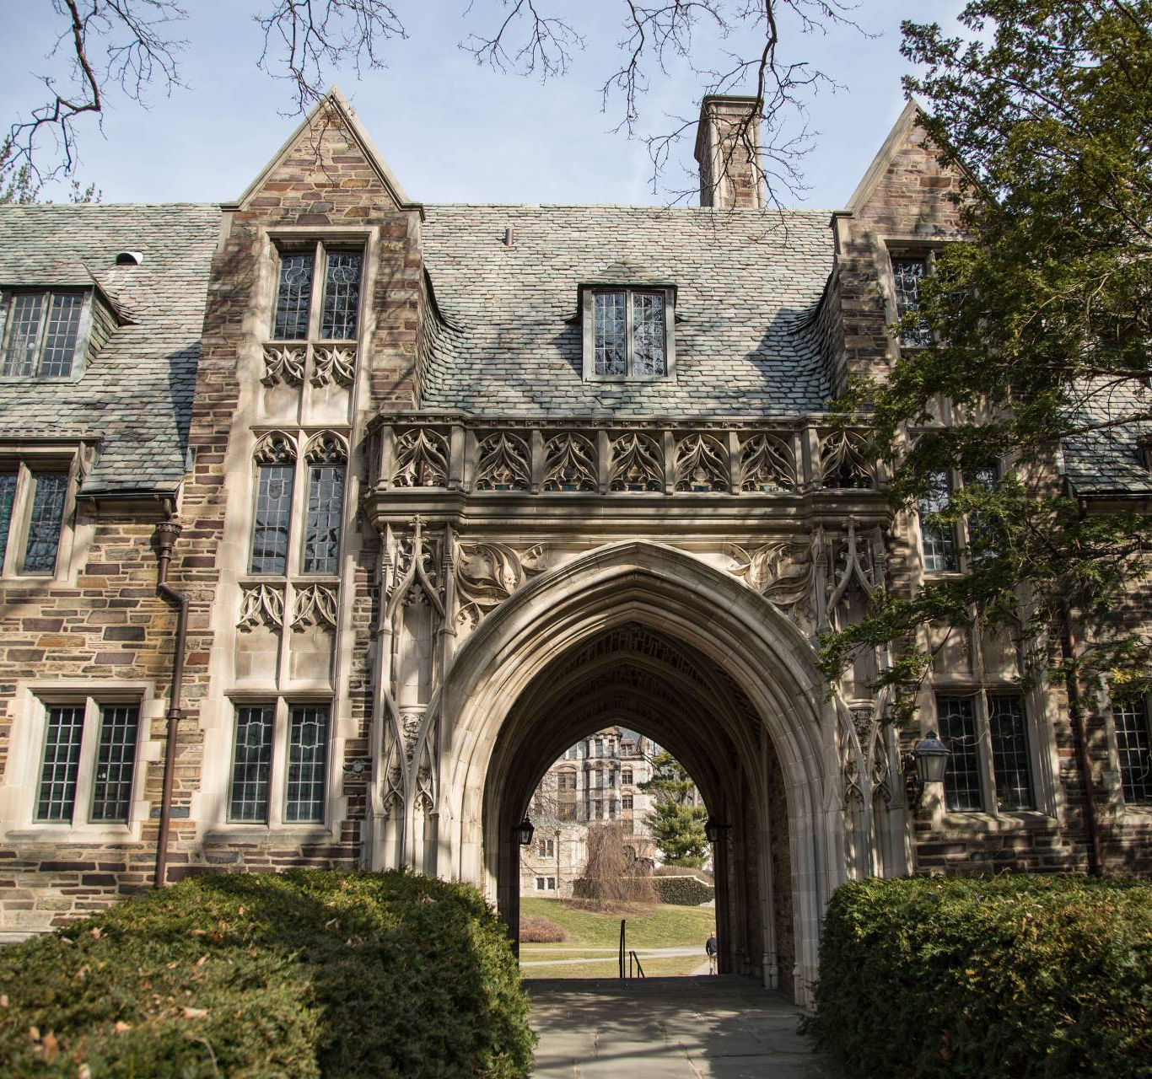
Tertiary Education
“A highly-skilled workforce, with a solid post-secondary education, is a prerequisite for innovation and growth: well- educated people are more employable, earn higher wages, and cope with economic shocks better”
Notes:
Higher Education (World Bank Education GP website) https://www.worldbank.org/en/topic/tertiaryeducation)

Slide 4
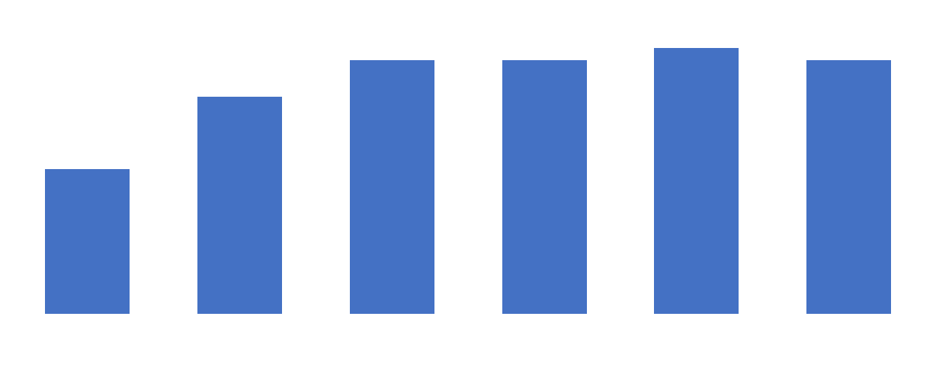
Expenditure on Tertiary Education
(% of government expenditure on education)
Notes:
UNESCO, UIS

Slide 5
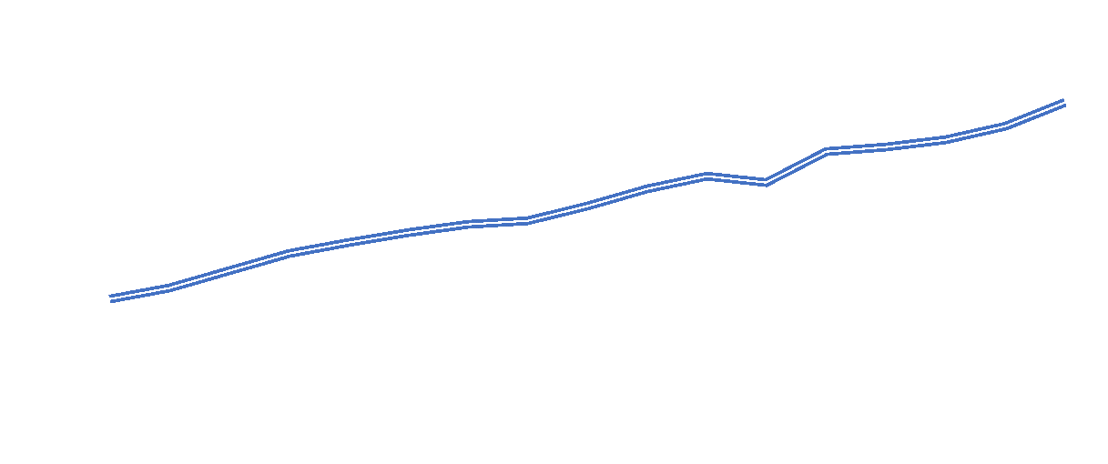
Global Enrollment in Tertiary Education is Increasing (millions of students)
Notes:
Francisco Marmolejo

Slide 6
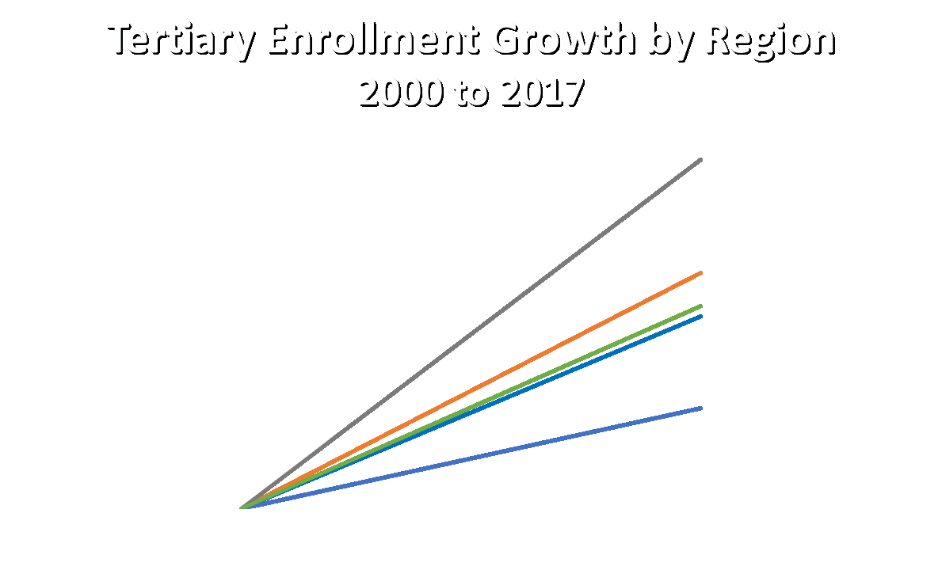
Notes:
WDI

Slide 7
Private Returns to Education

Slide 8
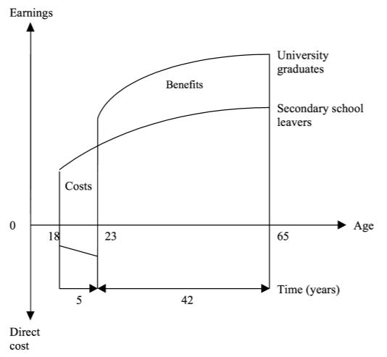
Private Returns to Education
Notes:
Psacharopoulos, G. (2018). Benefits and Costs of the Education Targets for the Post-2015 Development Agenda. In B. Lomborg (Ed.), Prioritizing Development: A Cost Benefit Analysis of the United Nations' Sustainable Development Goals (pp. 119-142). Cambridge: Cambridge University Press. doi:10.1017/9781108233767.008

Slide 9
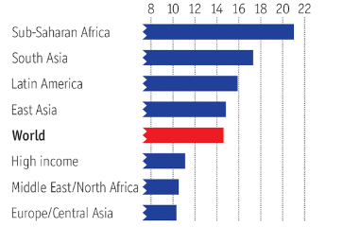
Private Rates of Return to Education
Notes:
The Economist, based on Psacharopoulos and Patrinos 2018

Slide 10
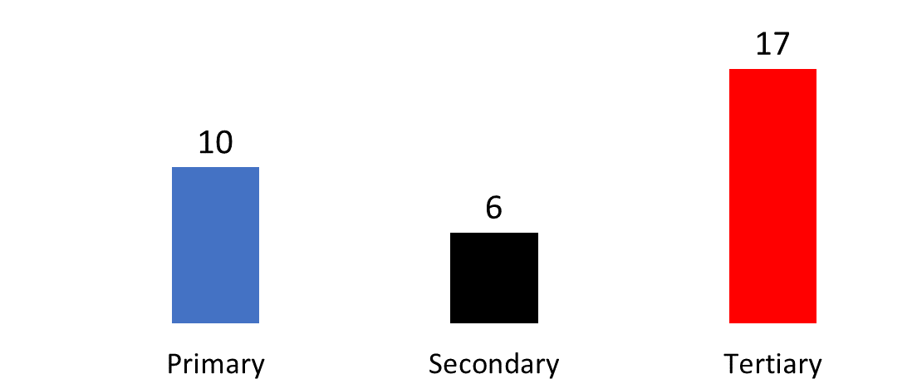
Private Rates of Return to Education by Level
Notes:
Psacharopoulos and Patrinos 2018

Slide 11
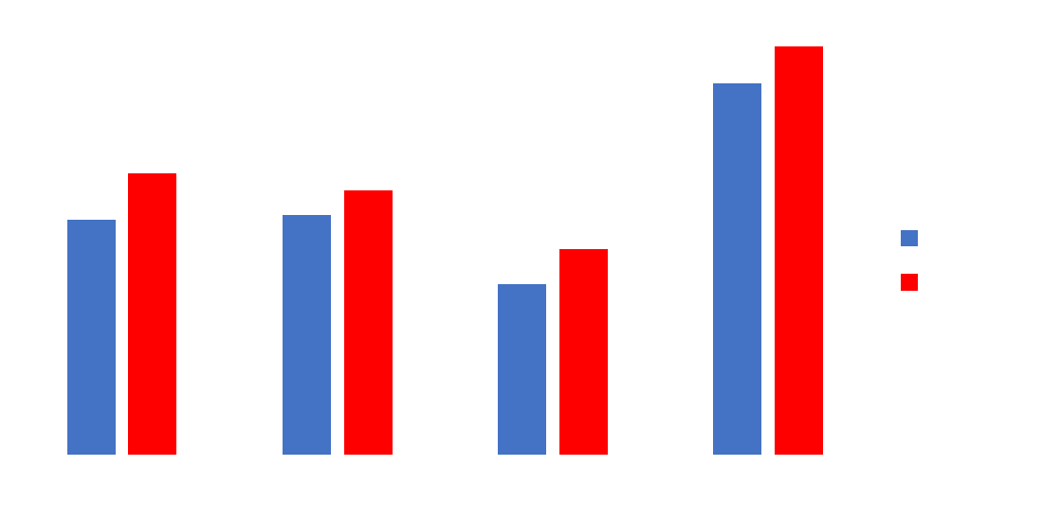
Returns Higher for Women
Notes:
Montenegro and Patrinos 2014

Slide 12
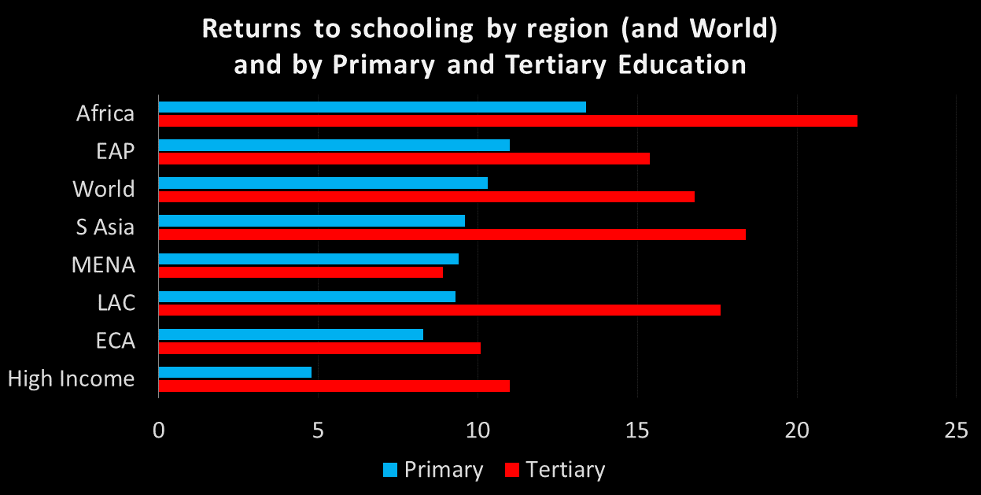
Returns highest at tertiary level
Notes:
Psacharopoulos and Patrinos 2018; Montenegro and Patrinos 2014

Slide 13


There are rising returns to higher levels of education, despite increases in supply
Vietnam 2006
+273%
+94%
Share of workers with tertiary education
Wage premiums to tertiary education
Source: Di Gropello and Sakellariou 2010.
Notes:
In Vietnam, wage premiums for educated workers grew three times as much as supply of educated workers between 1992 and 2006
Rates of return to an additional year of schooling in EAP is close to 11%. It ranges from 5% in Lao PDR to almost 17% in China.
Source: EAP Flagship

Slide 14
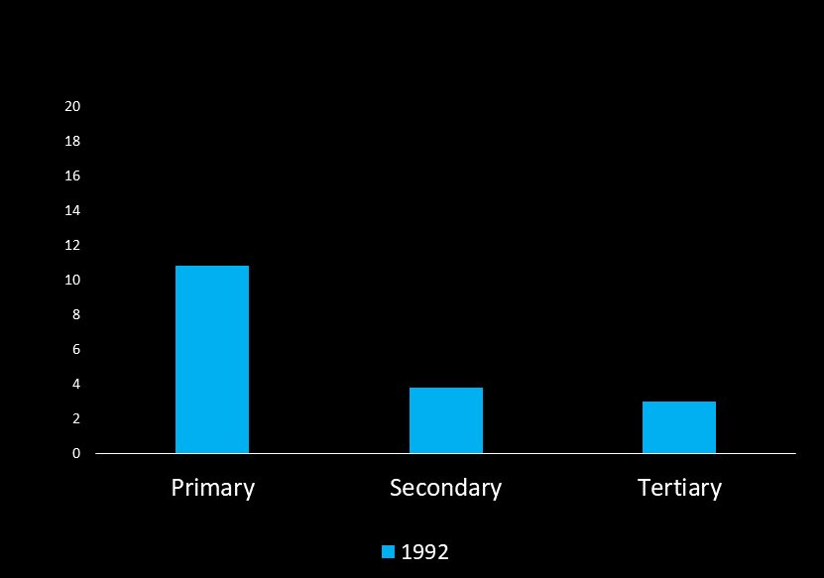
Rising returns to higher education in Vietnam
Notes:
Patrinos, Harry Anthony; Thang, Pham Vu; Thanh, Nguyen Duc. 2018. The Economic Case for Education in Vietnam (English). Policy Research working paper; no. WPS 8679. Washington, D.C. : World Bank Group. http://documents.worldbank.org/curated/en/115641545141262780/The-Economic-Case-for-Education-in-Vietnam

Slide 15
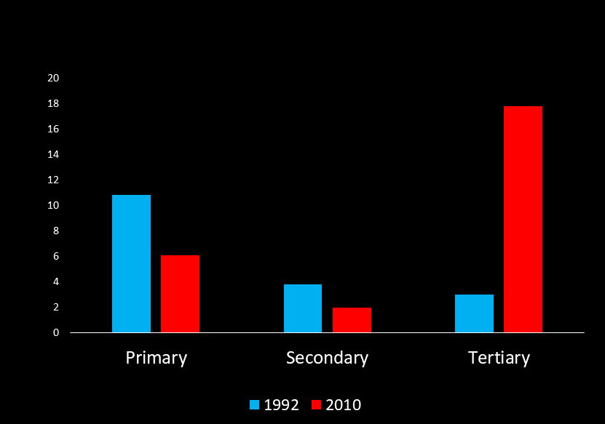
Rising returns to higher education in Vietnam
Notes:
Patrinos, Harry Anthony; Thang, Pham Vu; Thanh, Nguyen Duc. 2018. The Economic Case for Education in Vietnam (English). Policy Research working paper; no. WPS 8679. Washington, D.C. : World Bank Group. http://documents.worldbank.org/curated/en/115641545141262780/The-Economic-Case-for-Education-in-Vietnam

Slide 16
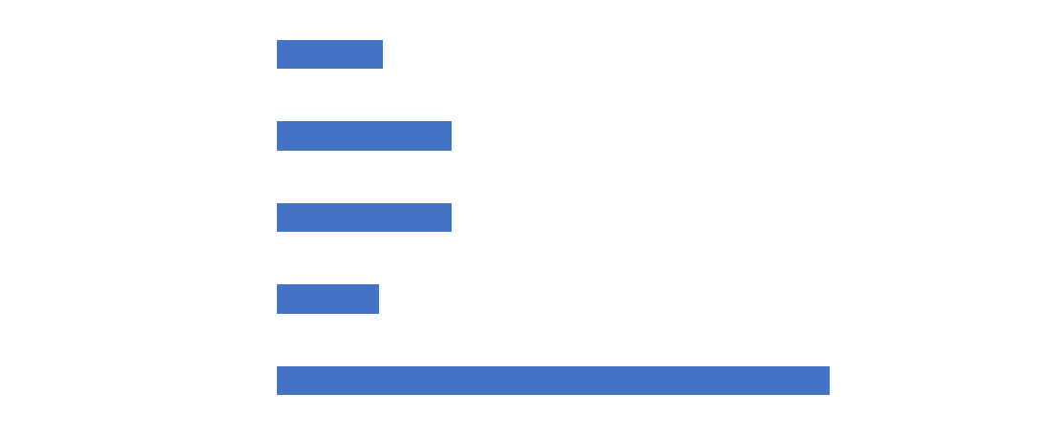
Returns to Alternative Investments (%)
Notes:
Psacharopoulos, Montenegro, Patrinos

Slide 17
Social returns for policy
Narrow social returns
incorporating direct market effects
Wide social returns
incorporating external and non-market effects

Slide 18
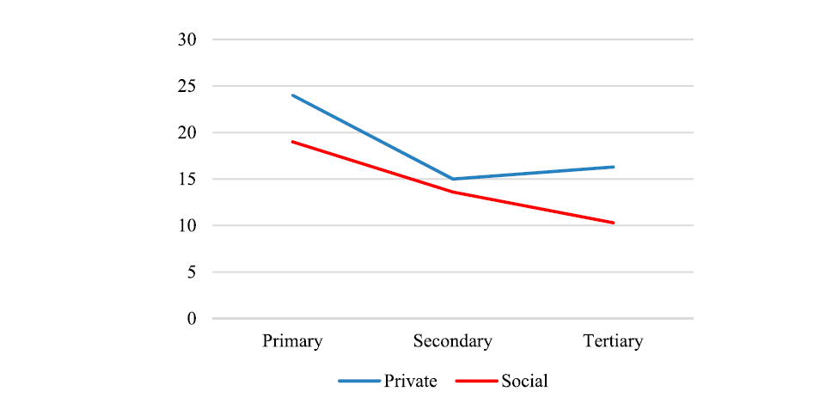
Social & Private Returns by Level
Psacharopoulos and Patrinos 2019
Notes:
Psacharopoulos and Patrinos 2018

Slide 19
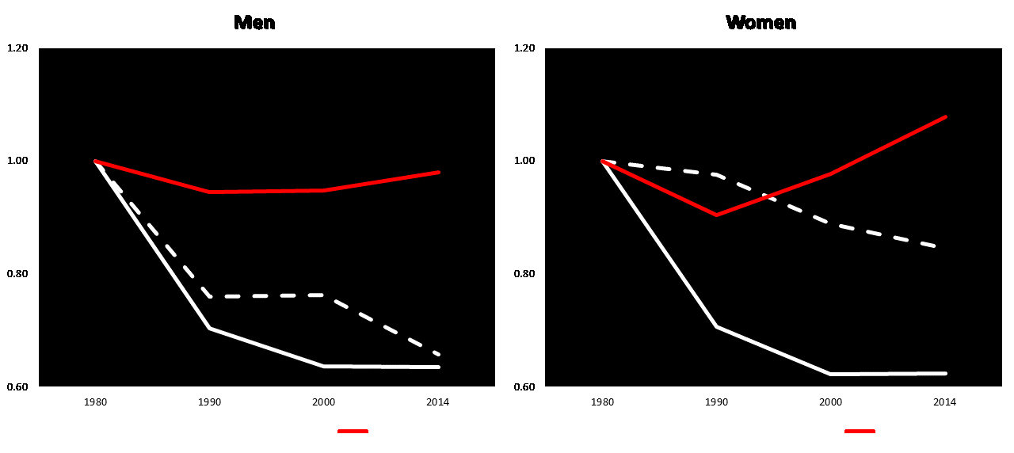
Global Changes in Returns since 1980
Notes:
Montenegro and Patrinos 2014

Slide 20
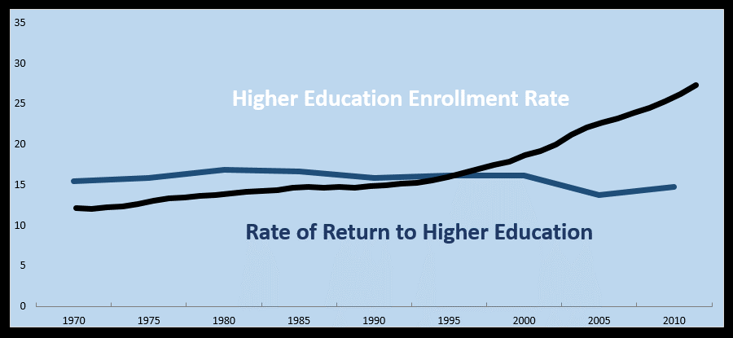
The Race Between Education & Technology
Notes:
Psacharopoulos and Patrinos 2018

Slide 21
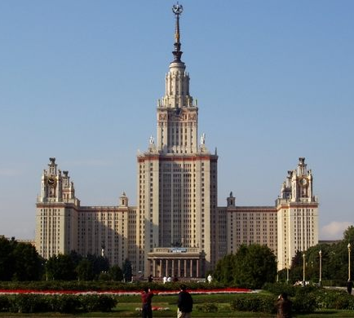
Implications
Efficiency
Inequality
Education reform
Financing reform

Slide 22

Private Returns to Tertiary, Azerbaijan 2015
Notes:
Garcia Moreno and Patrinos 2020

Slide 23
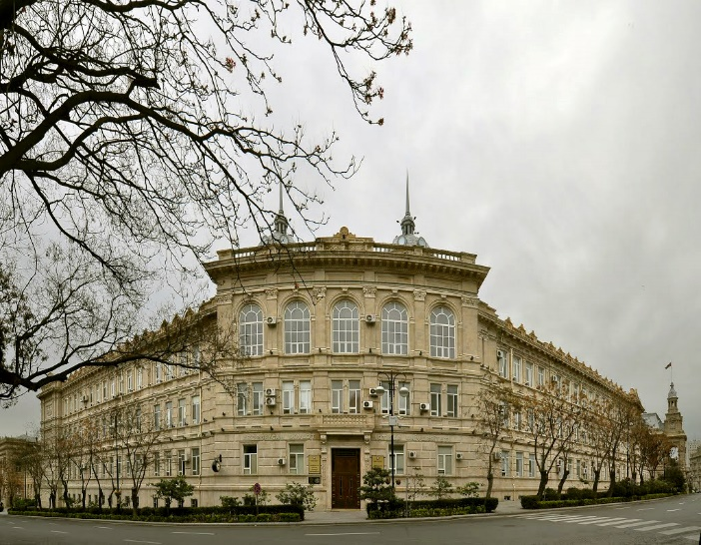
Cost per Student/Year (Nominal Manat 2015)
Tuition paying student | Public scholarship student
1800 | 1700
Notes: Local currency, manat; currently, 1 manat is equivalent to $ US 0.59
Notes:
Source: Azerbaijan Ministry of Education; Garcia Moreno and Patrinos 2020

Slide 24

Returns to Tertiary, Azerbaijan 2015
Notes:
Garcia Moreno and Patrinos 2020

Slide 25
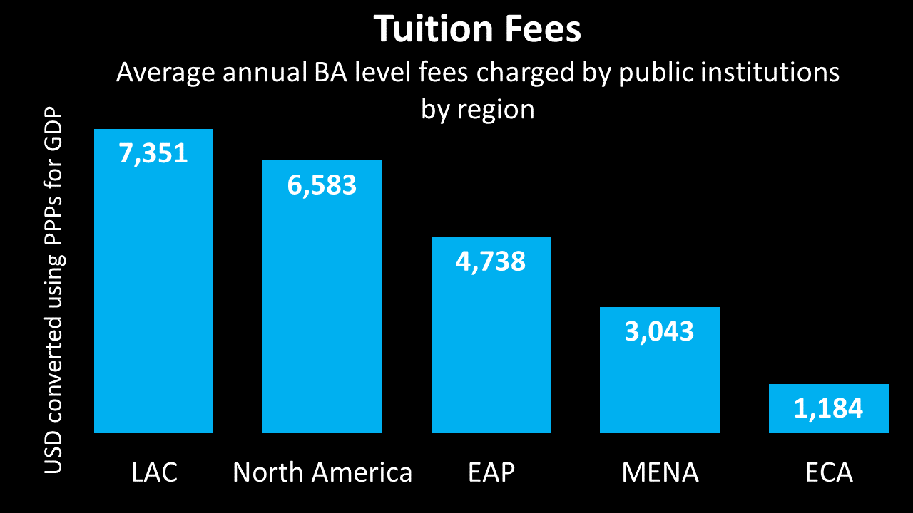
Notes:
OECD

Slide 26
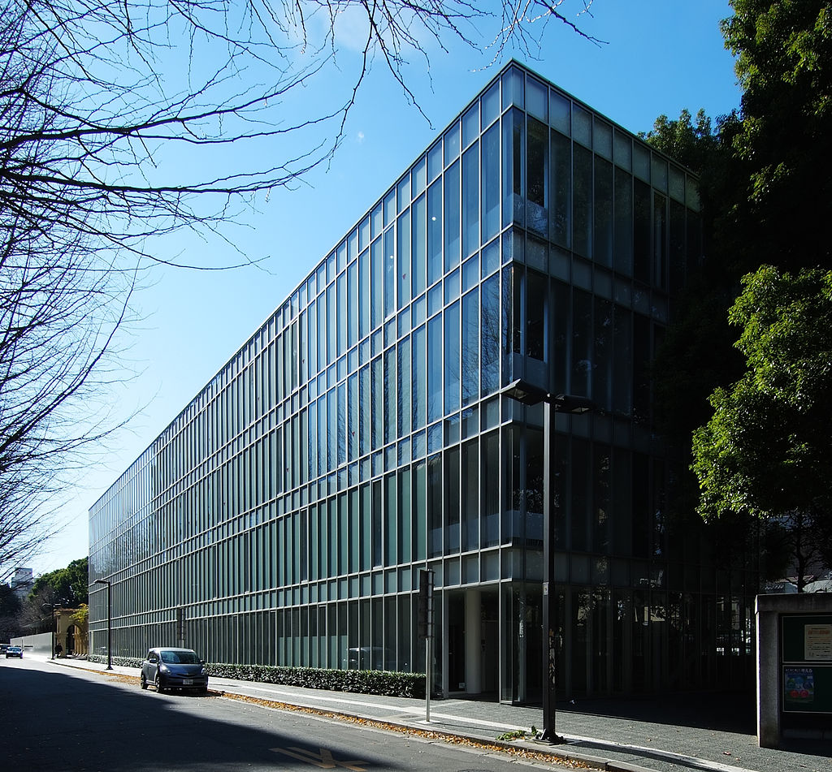
Private Share of Tertiary Education Financing
100%
United States
Australia, Japan
United Kingdom, Spain
Most of continental Europe
0%
Notes:
Psacharopoulos

Slide 27

Messages
Finance
Quality
Measure/Inform

Slide 28
Harry Anthony Patrinos
@hpatrinos

